Slide 1
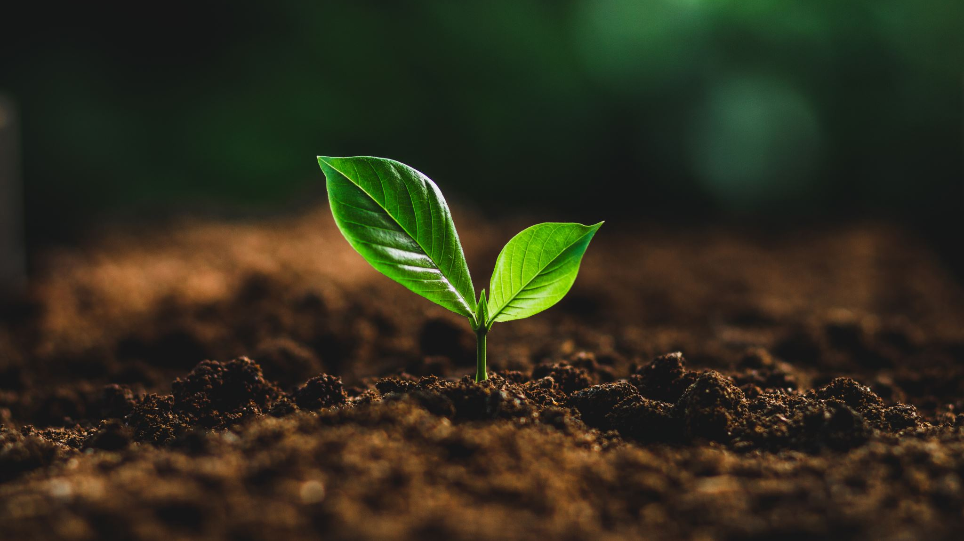
Identifying Plant Types with K-Means (CS 572 progress update)
Group: Juan
Lucas Larson & Victor Rodriguez
CS 472/572
5/4/2026
Notes:
“Good afternoon, We are Group Juan. Our project is unsupervised clustering of plant images using K-Means. We compare three feature pipelines: raw pixels, handcrafted color-and-texture features, and CNN embeddings; and we optimally choose the number of clusters using silhouette scores. Today we will show what we built since our last update, how we preprocess the data, our first quantitative and qualitative results, and a short look at the code.”

Slide 2
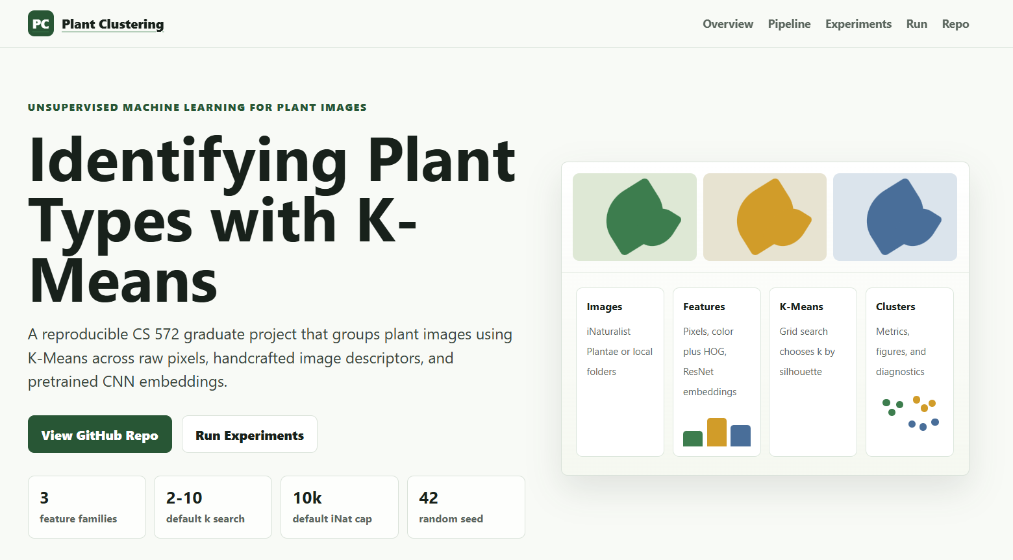
Project Link
GitHub repository: https://github.com/D3VTHSTVR/plant_clustering
GitHub Page:
https://d3vthstvr.github.io/plant_clustering/
Notes:
“Our code, README, environment file, and run instructions live in the repository on this slide. The project site link is our GitHub Pages site. The link is also in the footer of our slides for the rest of the talk.”

Slide 3
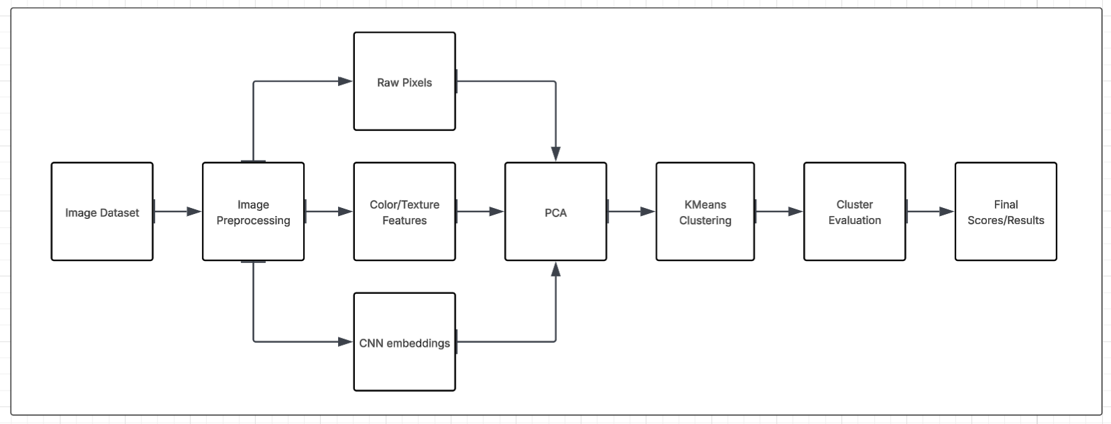
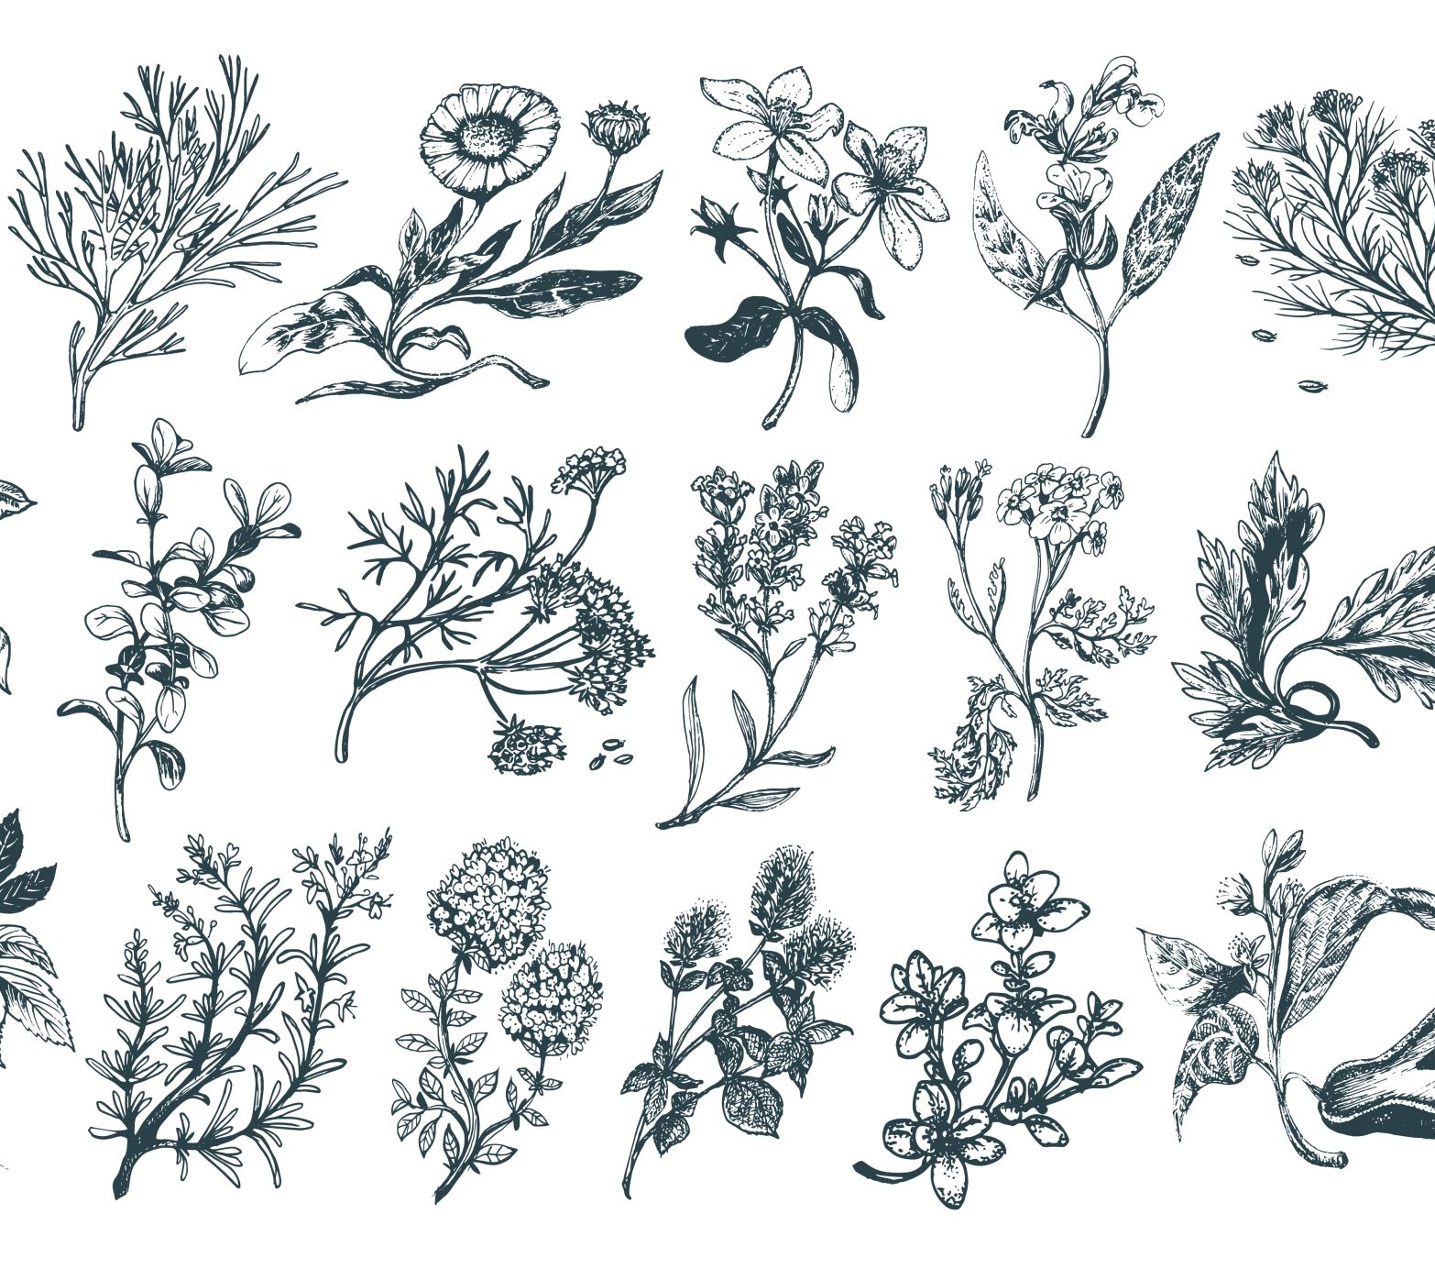
Goal & approach
Goal: meaningful clusters without supervision
Features: (1) raw pixels + standardize + optional PCA, (2) RGB histogram + HOG, (3) CNN embedding vector
Clustering: K-Means; sweep k; best k = argmax silhouette
Outputs: metrics.json, CSV, figures, config_snapshot.json from scripts/run_experiments.py
https://github.com/D3VTHSTVR/plant_clustering
Notes:
“Our goal is to see whether different feature pipelines produce coherent plant groupings. We run the same K-Means procedure on each feature matrix, sweep k over a configured range, and pick the k with the highest silhouette score on that representation. Our experiment driver logs everything to JSON and CSV and saves figures so the results are reproducible.”

Slide 4

Implementation update
WORKING PIPELINE:
LOAD, PROCESS, CLUSTER, EVALUATE
PROJECT STRUCTURE:
REORGANIZED PROJECT FILES AND ADDED ADAPTABILITY FOR CROSS-PLATFORM SUPPORT
PROJECT INTERFACE & OUTPUTS:
UPDATED CLI ENDPOINTS AND ADDED VISUAL OUTPUT METRICS
https://github.com/D3VTHSTVR/plant_clustering
Notes:
“Since the overview, we implemented a full experiment bundle, not just a notebook sketch. We start the project by running the main python script with a valid configuration. It loads images per the config—either the iNaturalist Plantae subset or through local folders—then runs each feature pipeline, tunes k, fits the final model, and writes metrics, creates a table, saved configuration snapshot, and plots.”

Slide 5
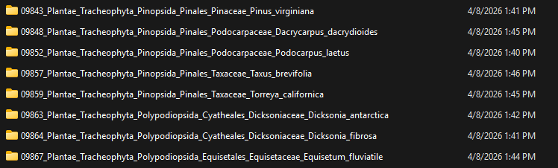
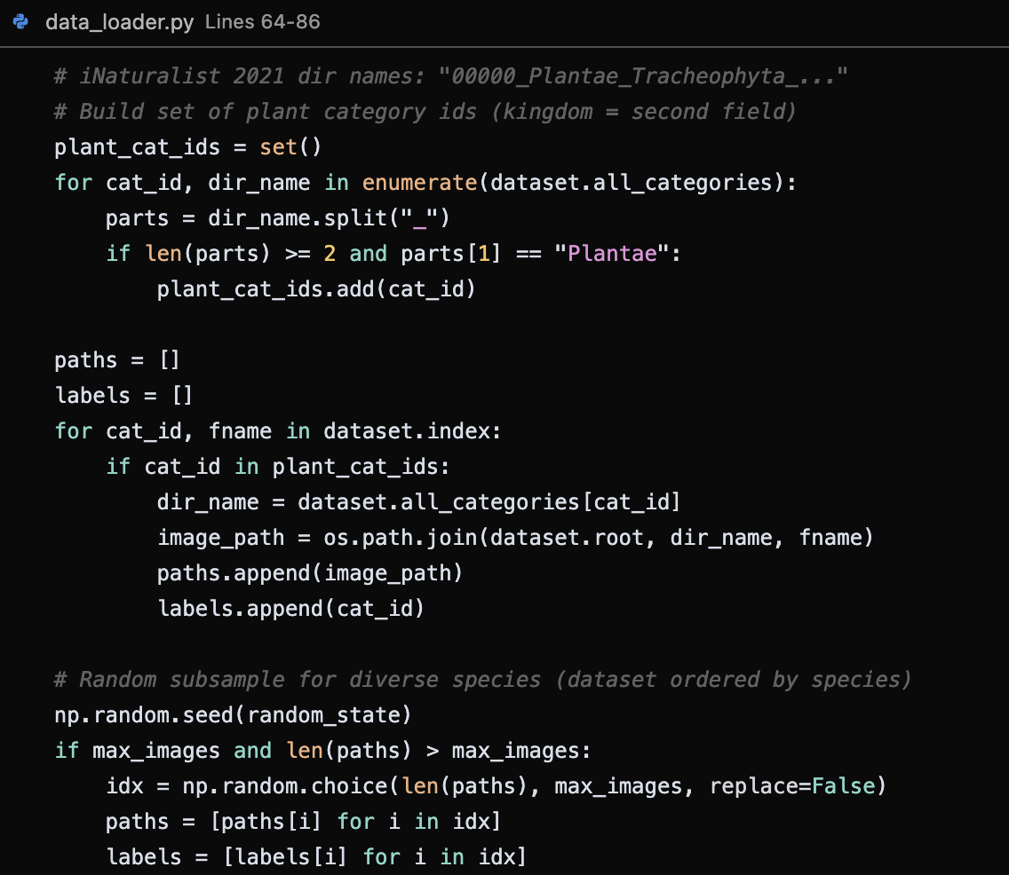
Data after preprocessing
Source: iNaturalist 2021 training set, kingdom Plantae (or local folders)
Subsampling: cap at 10k images for feasible runs; random seed for reproducibility
Transforms: resize 64×64 for raw and handcrafted; 224×224 for CNN; ImageNet normalization for CNN
Raw vector: 64×64×3 flattened (12,288 dims); often standardize + PCA (~95% variance retained) before clustering
https://github.com/D3VTHSTVR/plant_clustering
Notes:
“We use plant images from iNaturalist 2021, restricted to Plantae, with a configurable cap so experiments finish in reasonable time. Every run uses a fixed random seed. For preprocessing, we resize images to 64 X 64 for the raw and handcrafted pipelines, and to 224 X 224 for the CNN path with standard ImageNet normalization. Raw pixels are flattened; we typically standardize and reduce dimension with PCA before K-Means.”

Slide 6
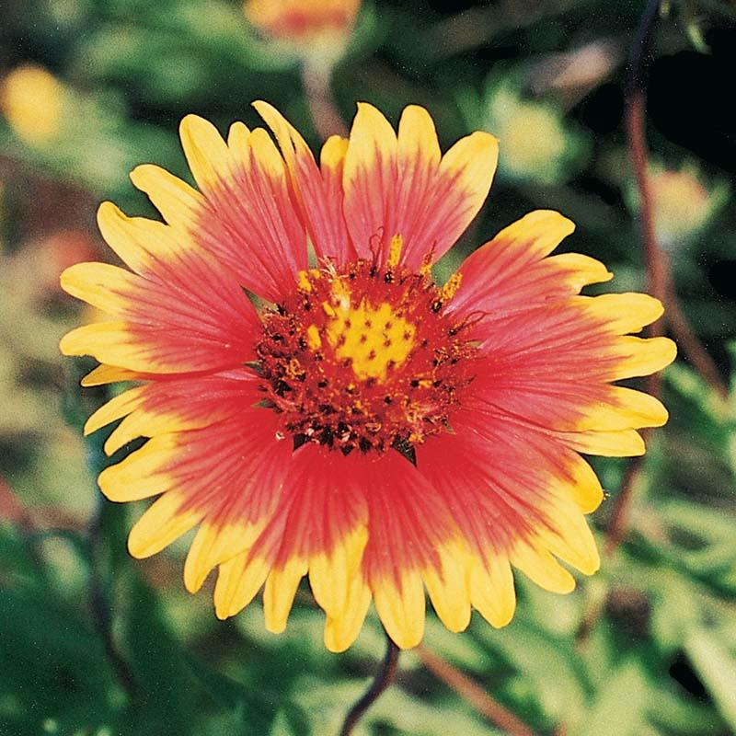

Features after preprocessing
Images resized: 64×64 for raw / handcrafted; 224×224 for CNN.
Raw pixels: flattened vector length 64×64×3 = 12,288 (then standardize + optional PCA retaining ~95% variance).
Handcrafted: RGB histograms (32 bins × 3 channels) + HOG -> fixed-length vector per image.
CNN: ImageNet-normalized tensors -> embedding vector from backbone without the final classifier (e.g. ResNet-18).
https://github.com/D3VTHSTVR/plant_clustering
Notes:
Preprocessing isn’t just resizing. For raw pixels we flatten reduce dimension with PCA because K-Means struggles in very high dimensions. Handcrafted features compress color and gradient structure using HOG (histogram-oriented gradient). The CNN features use a pretrained network to get a dense embedding per image.

Slide 7
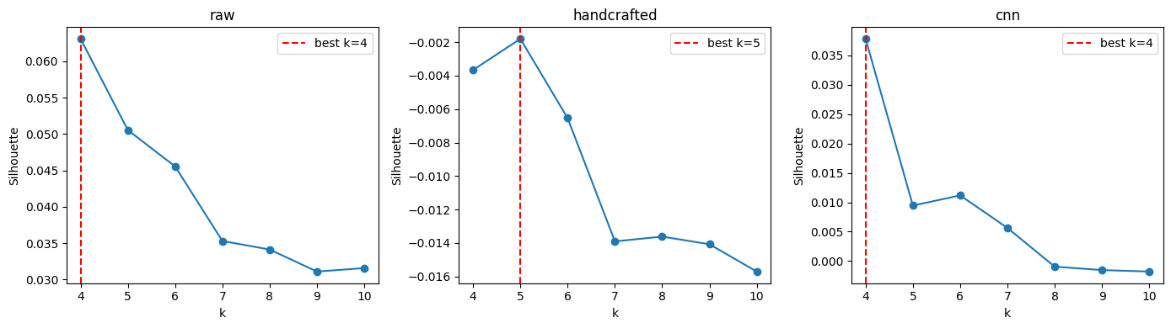
Initial experimental results
Silhouette vs k for raw, handcrafted, and CNN
Best k (red vertical line): raw 4, handcrafted 5, CNN 4
Raw silhouette highest in this run (~0.06 peak); handcrafted near or below zero; CNN strong at k=4 then weaker
https://github.com/D3VTHSTVR/plant_clustering
Notes:
We use sklearn K-Means with k-means++ initialization for clustering. For each feature type we sweep k and pick the k with highest silhouette. We’re also running a small ablation on raw pixels with PCA turned off to see how sensitive results are.

Slide 8
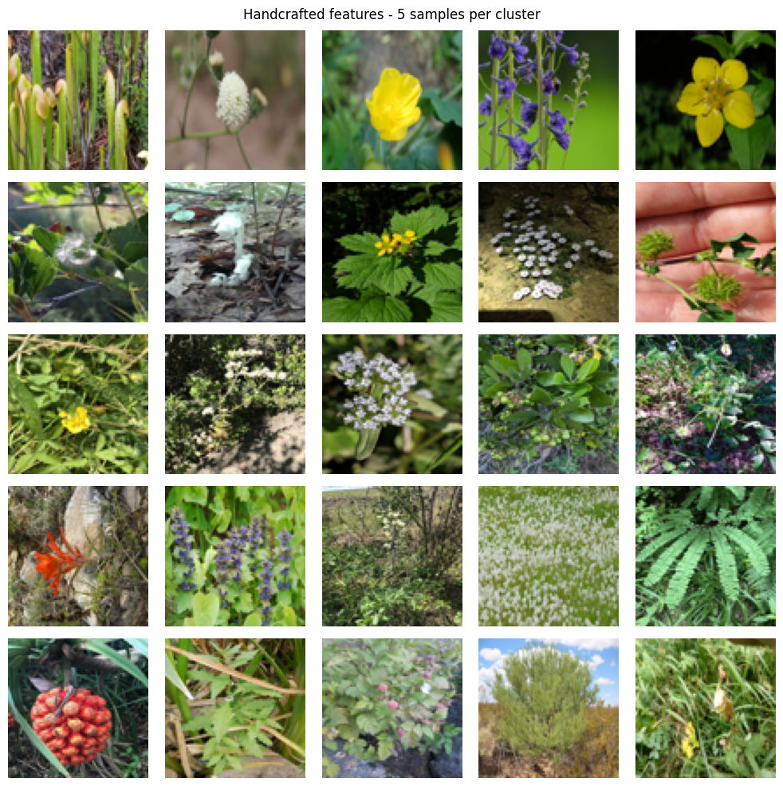
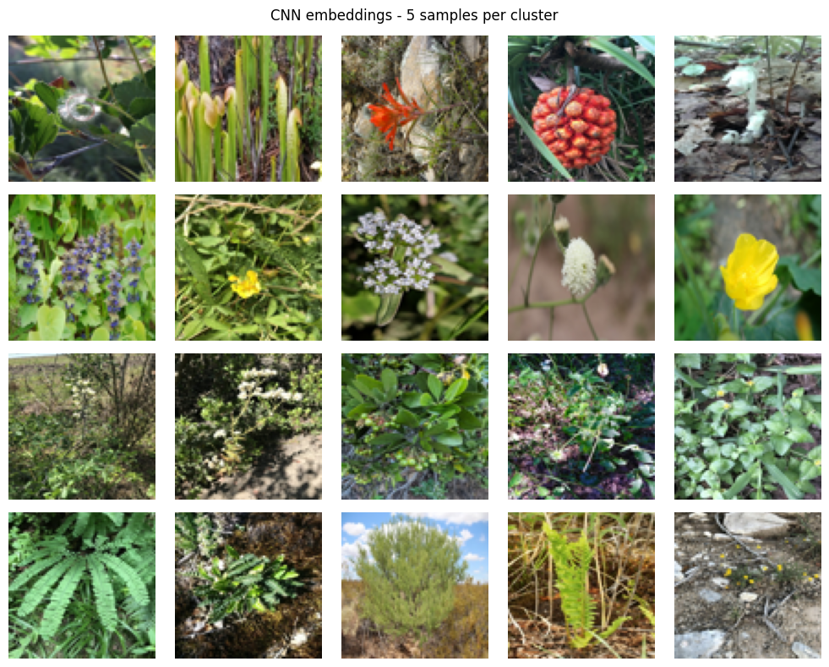
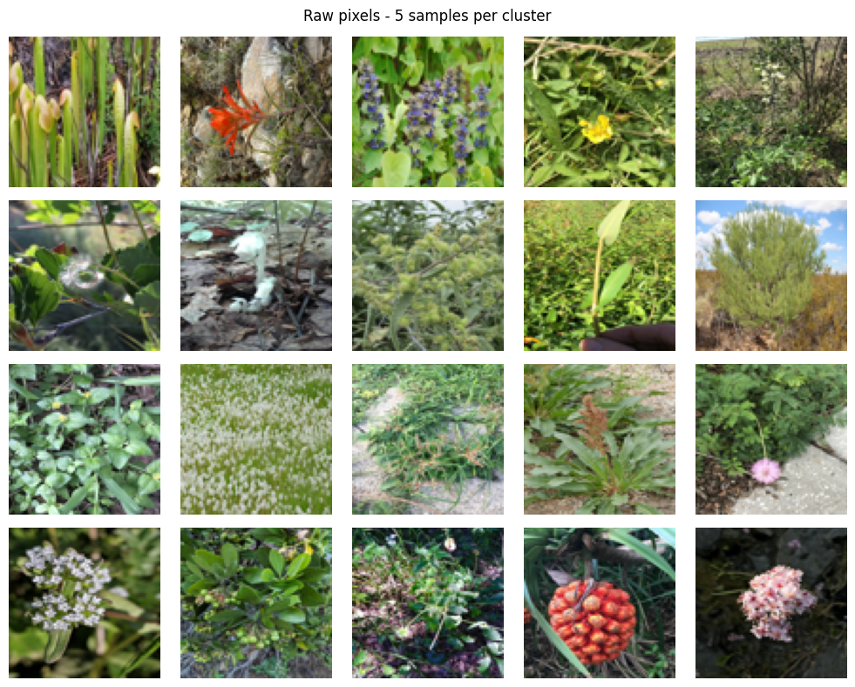
Initial results
Raw: mixed semantics but some color/texture grouping at low resolution
Handcrafted: some color-driven rows; metric weak despite visible structure
CNN: rows look interpretable | flowers vs dense foliage vs fern-like structure
https://github.com/D3VTHSTVR/plant_clustering
Notes:
“Here we show five random—or representative—images per cluster for each representation. For raw pixels at sixty-four by sixty-four, clusters are partly driven by color and coarse texture, but rows are still quite mixed. Handcrafted features combine color histograms and HOG; visually some rows share dominant green or floral structure even though silhouette was poor, which suggests the feature space may not be Euclidean-friendly for K-Means. For CNN embeddings at k equals four, rows look more semantically organized—for example one row emphasizes isolated flowers, another dense leafy groundcover, another fern-like or repetitive foliage—without ever training on taxonomic labels. That is the qualitative evidence we want alongside the silhouette curves.”

Slide 9
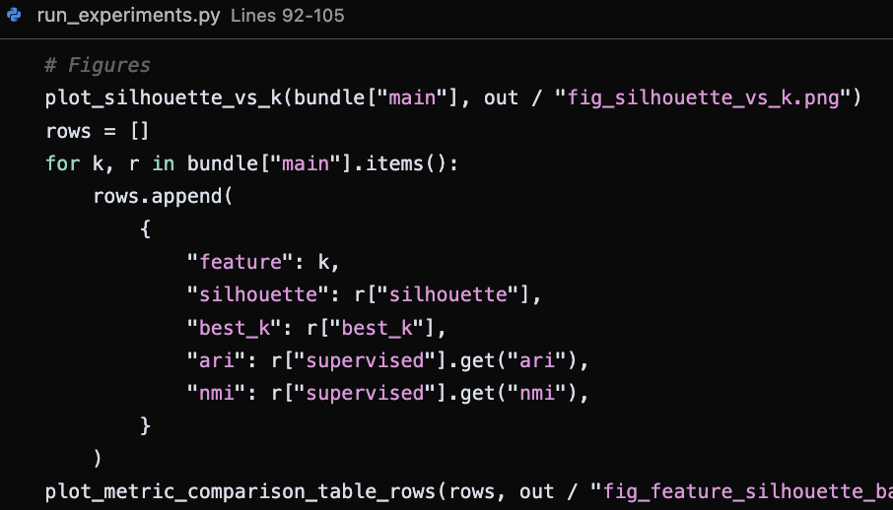
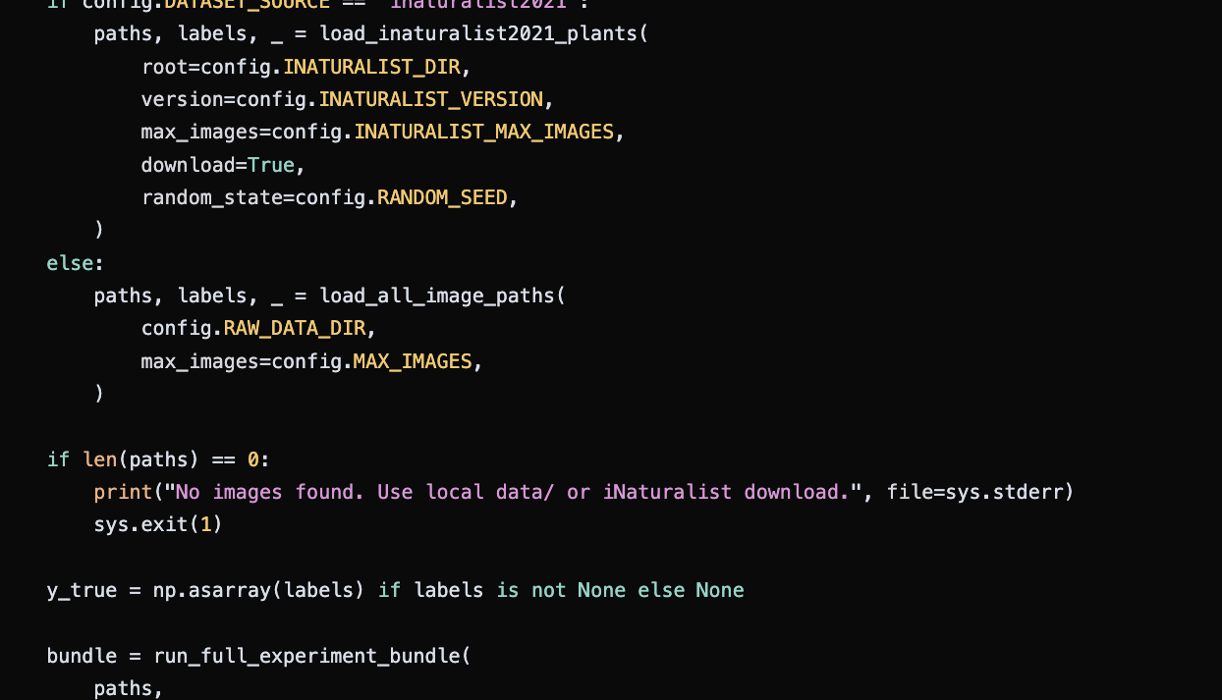
Discussion & next steps
What results suggest: silhouette favors small k and raw in this run; CNN gives interpretable partitions at k=4; handcrafted needs re-tuning or different scaling / dimensionality
Open questions: does PCA variance or HOG cell size explain handcrafted failure? does CNN benefit from different k or backbone?
Next steps: finalize N and k range for final report; document runtime; expand per-cluster samples; relate low ARI/NMI to limitation_notes in code; final paper PDF and Drive deck naming per instructions
https://github.com/D3VTHSTVR/plant_clustering
Notes:
“Our results suggest high silhouette on raw pixels may partly reflect compact clusters in a heavily reduced PCA space, not necessarily botanical species. The negative handcrafted silhouettes warn us not to trust k selection on that curve alone—we may adjust bin counts, HOG parameters, or try normalization. CNN clusters look meaningful at four groups but the metric degrades for larger k, which could mean splitting fine-grained classes hurts cohesion. For the final submission we will lock subsample size and k range, add runtime notes, show more qualitative examples, and connect supervised diagnostics like ARI and NMI to limitations stated in our evaluation module.”

Slide 10
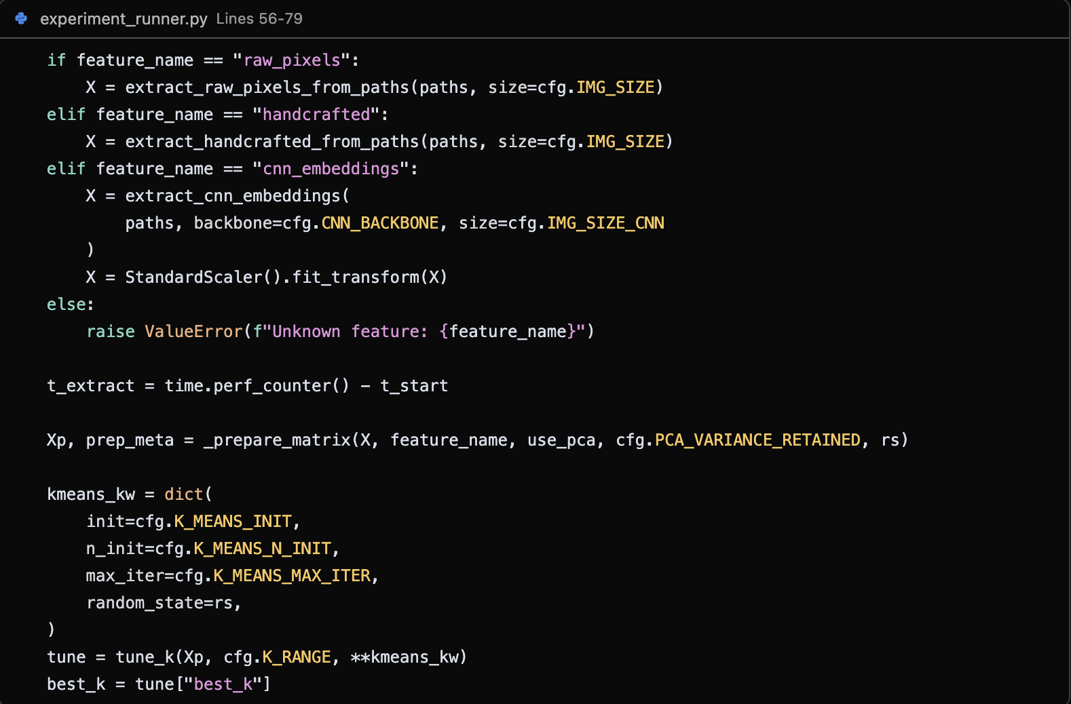
Code snippet
https://github.com/D3VTHSTVR/plant_clustering
Notes:
“This snippet is the core of our implementation. For each feature name we call the corresponding extractor with the image size from config. CNN embeddings are standardized before clustering. Then _prepare_matrix handles scaling and optional PCA for raw pixels. We build K-Means keyword arguments from config, call tune_k over the configured k range, and read off best_k. The rest of the function—not shown—computes silhouette, optional supervised metrics, and saves outputs.”

Slide 11
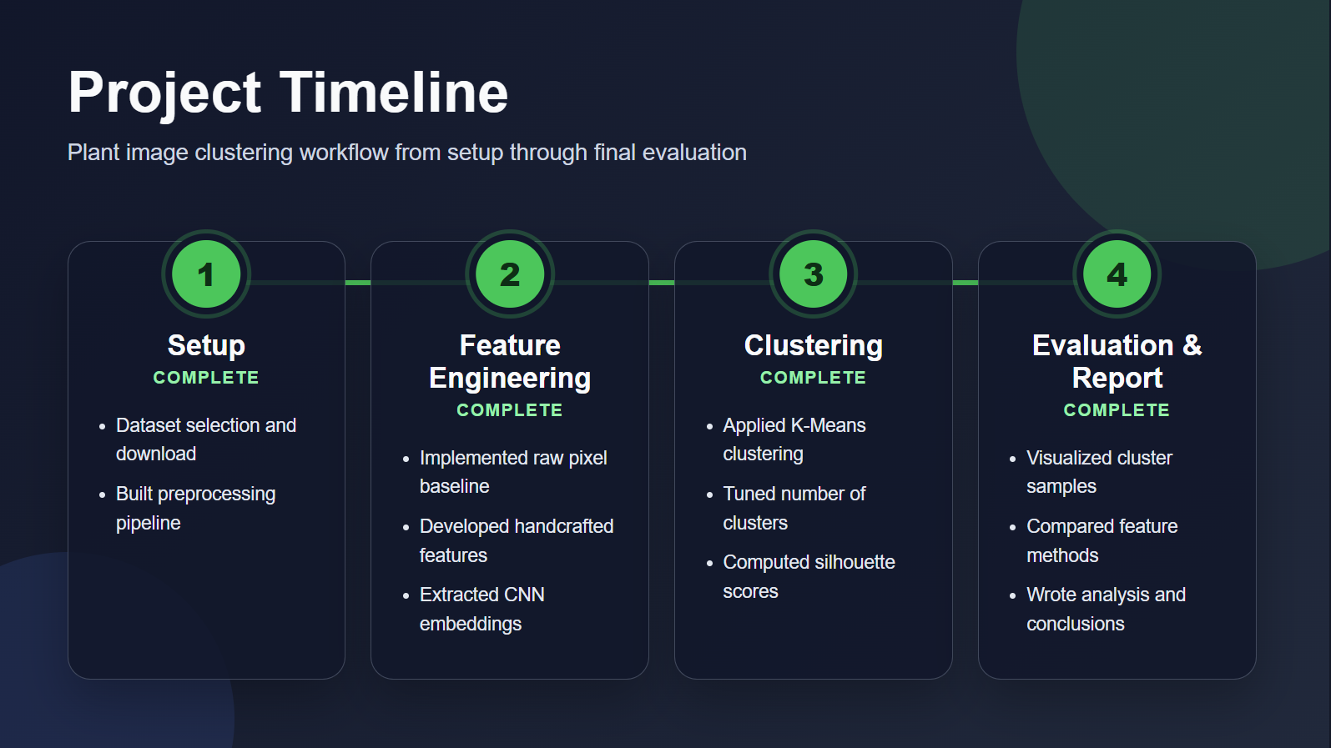
Timeline
Phase 1: Setup
Dataset selection and download
Build preprocessing pipeline
Phase 2: Feature Engineering
Implement raw pixel baseline
Implement handcrafted features
Implement CNN embedding extraction
Phase 3: Clustering
Apply KMeans
Tune number of clusters
Compute silhouette scores
Phase 4: Evaluation and Report
Visualize cluster samples
Compare feature methods
Write analysis and conclusions
https://github.com/D3VTHSTVR/plant_clustering
Notes:
Our project’s codebase is complete and pushed to GitHub. We’ve created a GitHub page for all the info about this project for future researchers to use.
We have finished implemented all of our planned features and proved the projects feasibility.
Next, we are finishing the final report and we will submit our project to canvas.

Slide 12
Thank you
https://github.com/D3VTHSTVR/plant_clustering

